Slide 1
Statistical Thinking and Flow Cytometry
Jocelyn Sendecki
15 May 2023
Date
Martin Freeman, Untitled
Diagnosed with AIDS in 1990, Martin lives in
San Francisco where he continues to create new pieces.

Slide 2
Discovery Statistics: Who are we?

Slide 3
Discovery Statistics within R&D
R&D
John Reed
Global Development
Kate Owen
Therapeutic Areas
Discovery & Manufacturing
Rich Tillyer
...
Discovery Statistics
Helena Geys
Preclinical Sciences and Translational Safety
Cindy Afshari
Statistics and Decision Sciences
Cyrus Hoseyni
Translational Medicine& Early Development
Surya Mohanty
Therapeutics Discovery
Emma Parmee
Onco
Peter Lebowitz
Neuro
Bill Martin
Immuno
David Lee
ID
James Merson
GPH
Ruxandra Draghia
VAC
Penny Heaton
CVM
James List
Data Science
Najat Khan
Notes:
Stress – connection with TA and other supporting groups at level of Peter Ronco
Departments more important than actual name.

Slide 4
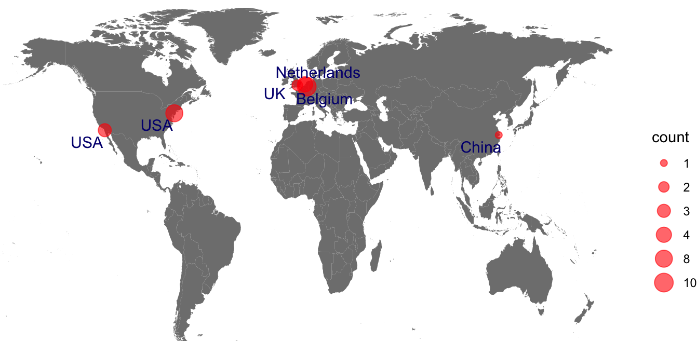
Discovery Statistics Worldwide
FTE
Notes:
Or color zones and add number in zone? The bullets in EU all overlap.
Volha: visualize the size of the teams with visualizations used in data analysis as well. Keep the coloring for the TA’s.
Bring in pictures/names.

Slide 5

Immunology
(Jocelyn Sendecki-SH)
Oncology
(Bie Verbist-BE)
Infectious Diseases
(Marjolein Crabbe)
Vaccines
(Jan Serroyen-NL)
Davit Sargsyan-SH
Traymon Beaver-SH
Kristen Kohler-LJ
Elli Makariadou-BE
Ewoud De Troyer-BE
Evangelos Kanoulas-UK
Jeroen Tolboom-NL
Sarah Janssen-NL
Leacky Muchene-NL
Xuechen Wang-SH
Nicholas Heinz-SH
Luwis Diya-BE
Discovery Statistics (Helena Geys-BE)
Neuroscience
(Ondrej Libiger -LJ)
Stephany Young-LJ
Mathias Bruckner-BE
Wim Van der Elst-BE
Alemu Assefa-BE
Cross-TA
(Helena Geys-BE)
Kanaka Tatikola-SH
Koen Van Den Berghe-BE
Fetene Tekle-BE
Mohammed Ibrahim-BE
CVM
(Jialin Xu)
Bin Gao-SH
Mahsin Md (CYTEL, Canada)
Vahid Nassiri (Open Analytics, Belgium)
Yingjie Zhie (Open Analytics, Belgium)
Kathy Mutambanengwe (Open Analytics, Belgium)
Javier Franco (Open Analytics, Spain)
Yannick Breton (IQVIA-Canada)
Hannah Lennon -F
Biancamaria Florenzi (Open Analytics, Belgium)
Pharmalex

Slide 6
A show of hands, please
Statistics basics (~ 10 slides)
How our team currently analyzes flow data (~10 slides)
Unsupervised clustering – how PCA, t-SNE, and UMAP work (~25 slides)
Heatmaps (~3 slides)
Data transformations – Bi-ex vs. log vs. arcsinh (4 slides)
Discussion topics
Automated gating
Events and power
Dose response as a way to model fold expansion

Slide 7
Statistics Basics

Slide 8
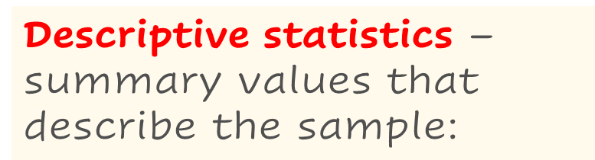


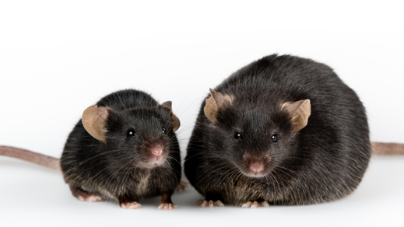
Stats Basics: Frequentist Statistics
Population
Random selection
Sample
“20% of mice are blue”
Inferential statistics – making generalizations / testing hypotheses about a population based on the sample:
“20% of mice are blue, with a 95% confidence interval of (8%, 49%).
This is statistically significantly lower than the 50% that was expected.”
Notes:
So let’s talk bout what statistics really are, and to do that we have to start with the population.
If we had all the money and time in the world, we could measure every single mouse in a population, and then we could just compare means or other parameters directly because e would literally know everything, with no error.
Nobody has that kind of time or money, so instead what we do is take a random sample from that population, and if we do it right, that sample should represent the population, and the means and varainces and other characteristics we calculate are called “statistics”, and they inform us about the parameters of the population. Statistics from the sample tell us about parameters in a population.
There are two kinds of statistics that we us. First, descriptive statistics – for example, here we could say that in our sample 20% of mice are orange. The second kind of statistics are the exciting kind – inferential statistics, and this is where we can make generalization or test hypotheses. 20% of mice from our sample are orange, which is significantly lower than then 50% that we expected, p less than 0.05. You need both to tell the full story around an analysis – If I just come in and say, hey my data is significant! That makes no sense – and we’ll talk a little more about descriptive statistics in a few slides.

Slide 9

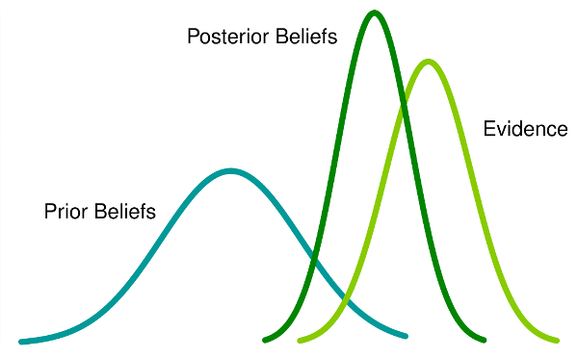
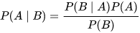
Statistics Basics: Bayesian Statistics
Posterior = Likelihood x Prior ÷ Evidence
Thomas Bayes, allegedly
Some distributions work very well together
Beta and Binomial
Dirichlet and Multinomial

Slide 10


Independence
P(H) = 0.5
P(2H) =
P(H)*P(H) = 0.25
P(3H) =
P(H)*P(H) *P(H) = 0.125
Imagine you have a fair coin, with a 50% probability of heads on a coin flip, and 50% chance of tails
Perform 3 coin flips
What’s the probability of getting 3 heads?
When the probabilities of each event are unrelated to another, they are independent

Slide 11
In the context of multiple tests…
Assume Type 1 error is 0.05
Type 1 error is the probability of rejecting a true null hypothesis
If 5% of the time you are making the wrong conclusion, 95% of the time you’re making the right one
What’s the probability of making the right conclusion if you assume independence?
Type 1 error:
5%
Type 1 error: 9.75%
Type 1 error: 14.2%
0.95*0.95 = 0.9025
0.95*0.95*0.95 = 0.857
test 1
test 2
test 3
0.95
0.95
0.95
0.05
0.05
0.95
0.05
0.05
0.95
0.95
0.05
0.05
0.95
0.05

Slide 12
Statistics Basics: exploration vs confirmation
In exploratory research
Not establishing a particular theory
Not making specific claims
Hypothesis generation
In confirmatory research
More strict, should involve design of experiments
Should include sample size/power estimates
Must have a clear, testable primary hypothesis

Slide 13
More Independence
Independence is also an assumption within models
When probabilities of some event are unrelated to another, they are independent
Pre-post, repeated measures, longitudinal data, technical replicates are all NOT independent
There are various methods of accounting for this
Source of variance is known (being the same subject, repeatedly)
Methods allows that “noise” to be parsed, less noise = more signal
Cell abundance data is NOT independent
As one population goes up, others may go down
Data in lower gates is completely related to data in higher gates

Slide 14
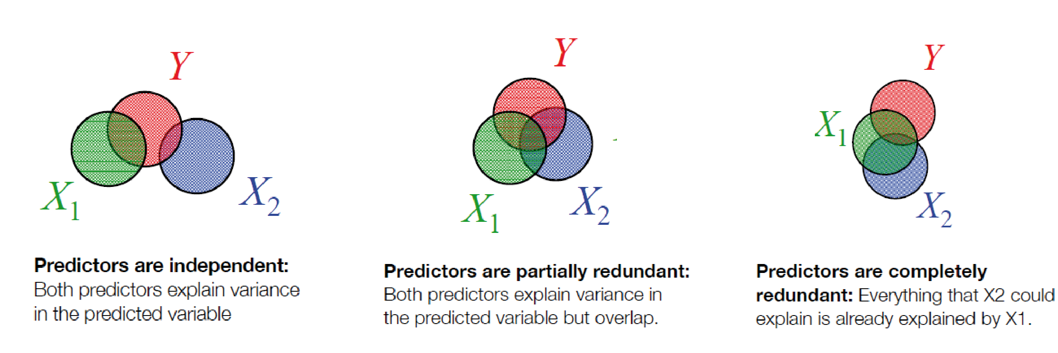
Statistics Basics – Correlation/Collinearity

Slide 15
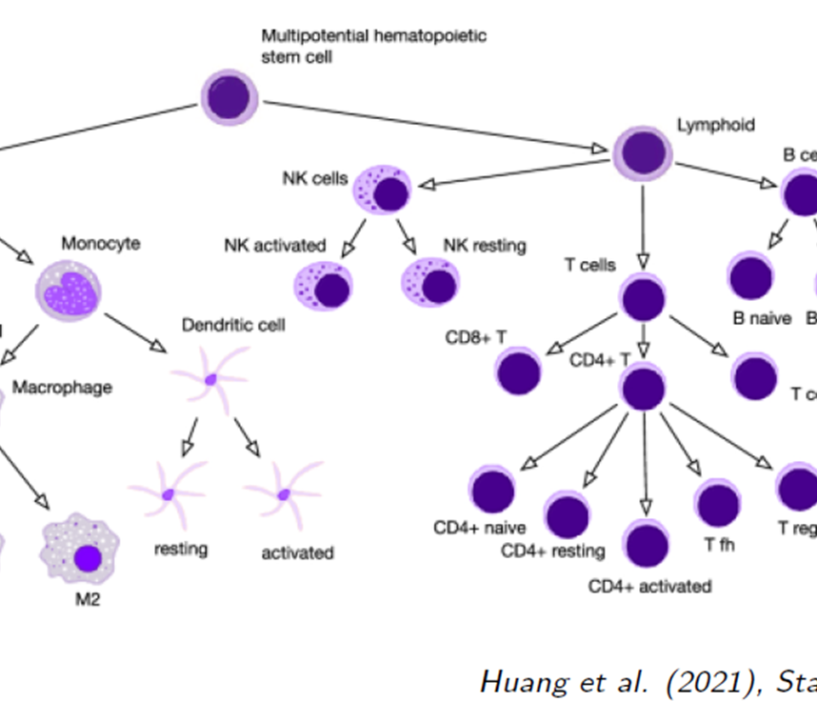
Hierarchical Data
The structure of flow cytometry data is naturally hierarchical
In our group, we have not typically modelled this full hierarchy
Questions are often focused on particular individual outcomes
Or on mutually exclusive outcomes
Or are very exploratory
Possible (future) approaches
SPADE – Spanning Tree Progression of Density-normalized Events
PhenoGraph
Which are network community plots
We do have experience here
https://www.immunology.pitt.edu/sites/default/files/3.pdf

Slide 16
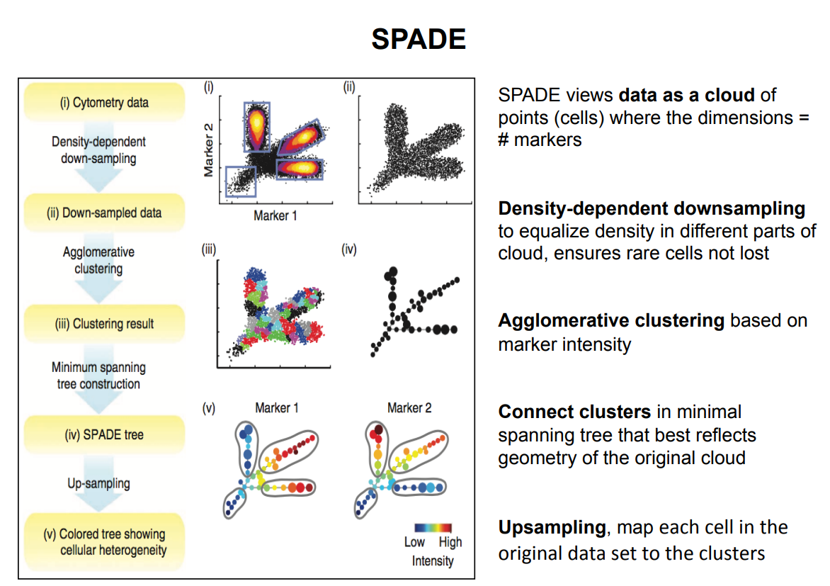

Slide 17
How statisticians think about/analyze flow data

Slide 18
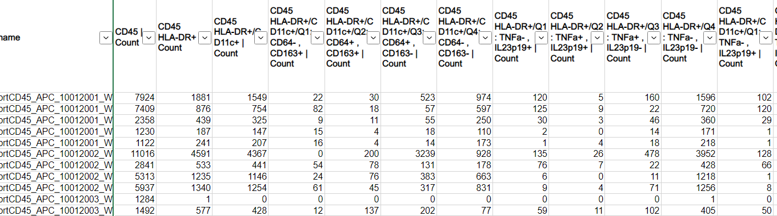
Flow data file

Slide 19
Starting small: Modeling cell counts
How do we model a single flow measurement?
Consider the distribution of the cell count (or relative %)
Large values (hundred – thousands of cells)
Count are technically Poisson (distribution of rare events)
If variability is high, Negative Binomial might work better
As counts increase, it approaches the Normal distribution (may need log-transformation
Small values (tens to hundreds of cells)
Poisson or Negative Binomial is a good start
Zero-inflated models might be needed (if there are more zeroes than expected)
If there is a lower limit of detection (like <50), a censored regression model might be appropriate

Slide 20
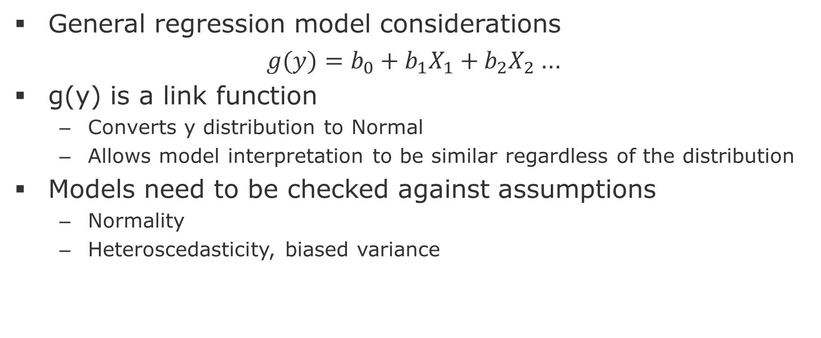
Starting small: Modeling cell counts
General regression model considerations
$g(y)=b_{0}+b_{1}X_{1}+b_{2}X_{2}$…
g(y) is a link function
Converts y distribution to Normal
Allows model interpretation to be similar regardless of the distribution
Models need to be checked against assumptions
Normality
Heteroscedasticity, biased variance

Slide 21
Exploratory or Confirmatory
If a scientist comes to us with a few outcomes that are well informed and have a good idea of what’s happening, especially when it comes to NME declarations, we treat this as confirmatory
Model outcomes individually
Adjust p-values using something like the False Discovery Rate
If a scientist comes to us with multiple gates and quadrants and wants to see every parent-child relative frequency plus ratios of various pathogenic vs immuno-protective cell expressions…
Exploratory (lots of individual models)
Model everything simultaneously
Bayesian Dirichlet-Multinomial
Compositional Data Analysis (limma-voom)

Slide 22
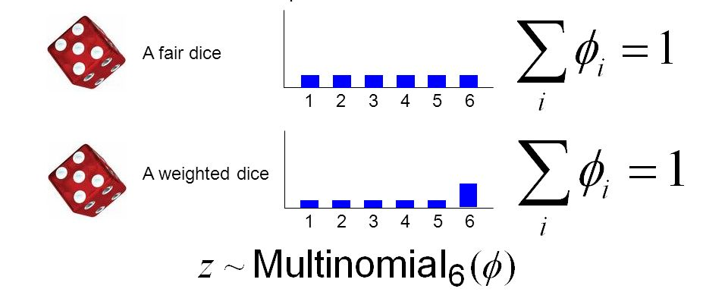
Multinomial Approach
Healthy
Cell types
Disease
As one cell type increases, the others decrease!

Slide 23
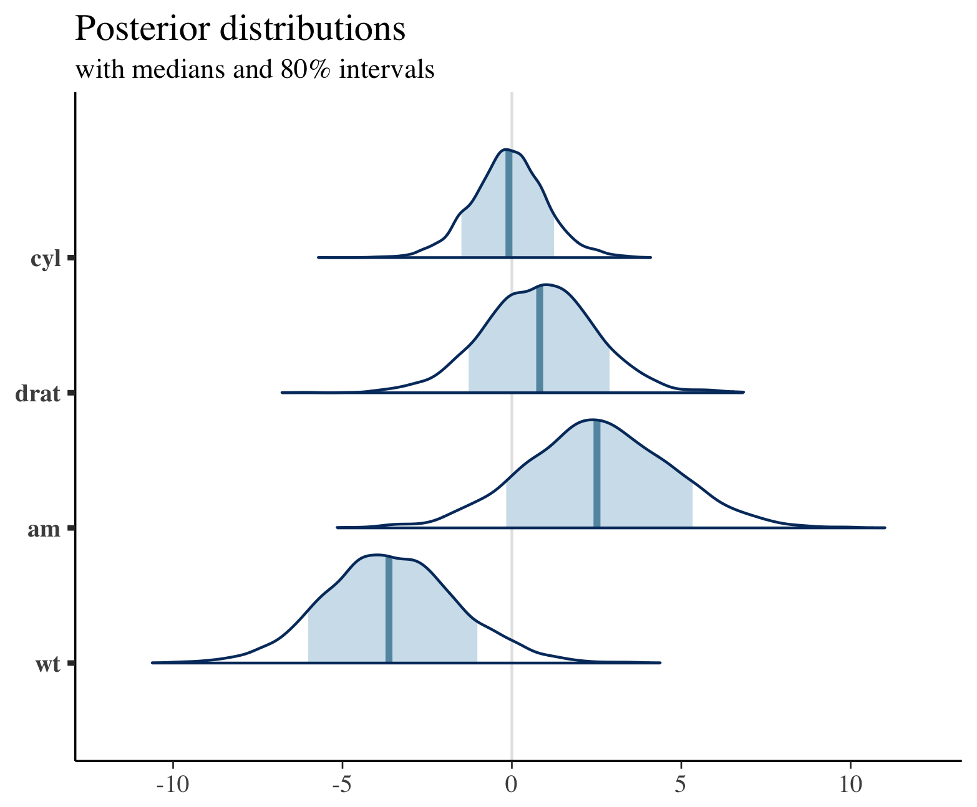
Bayesian Dirichlet-Multinomial
The binomial distribution predicts the probability of x successes in n trials, given p probability of success
If p = 50%, in 10 trials the probability of 5 successes is the highest
The beta distribution goes from 0 to 1 and describes the possibilities of the value of p
Your probability of success probably isn’t exactly 50%, but maybe just high in the middle
Bayesian Beta-Binomial gives a posterior probability of success, given shape of p
Bayesian Dirichlet-Multinomial does the same thing, but for multiple categories, not just success/failure

Slide 24
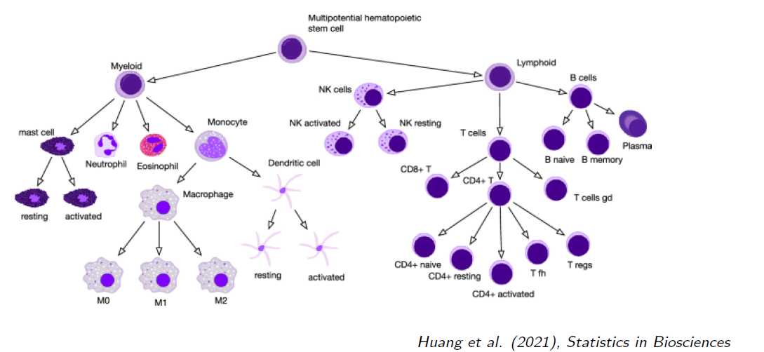
Changes in cell composition

Slide 25
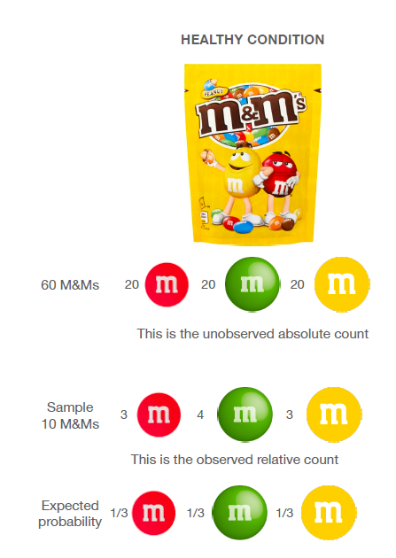
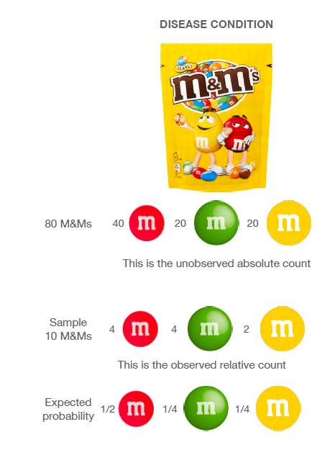
Cell abundance data are compositional
Healthy
Diseased
Even though only red changes in absolute levels, the relative abundance changes for all colors!!
Ignoring this correlation leads to dramatic false positive rates

Slide 26
Compositional Transformation
Ideally, we could compare absolute cell counts between samples, i.e., #cells/volume unit
Often, this is not possible, only relative abundance
Compositional transformation has roots in the microbiome literature
Uses ratios (Aitchinson, 1982)
Usually takes a population as a reference
Could be a combination of cells types
Could just be something like CD3

Slide 27
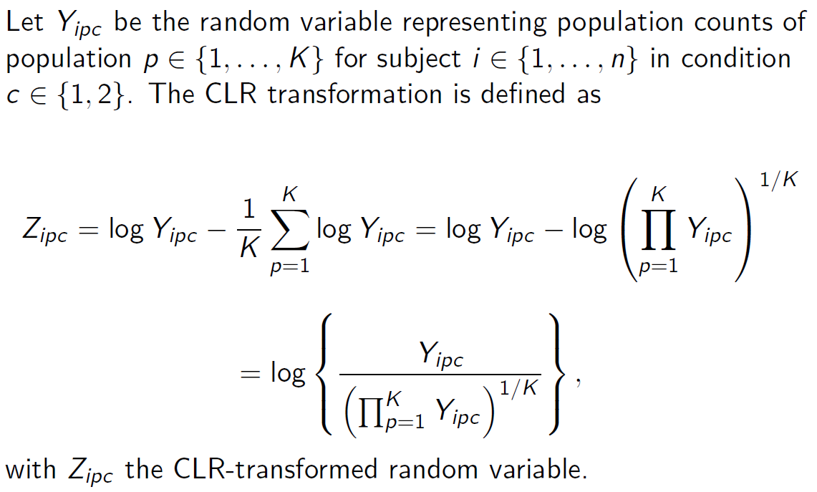
Centered log-ratio (CLR) Transformation

Slide 28
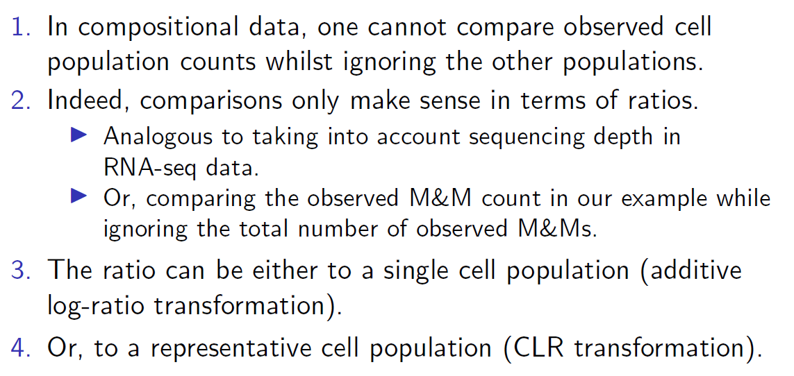
Why CLR?

Slide 29
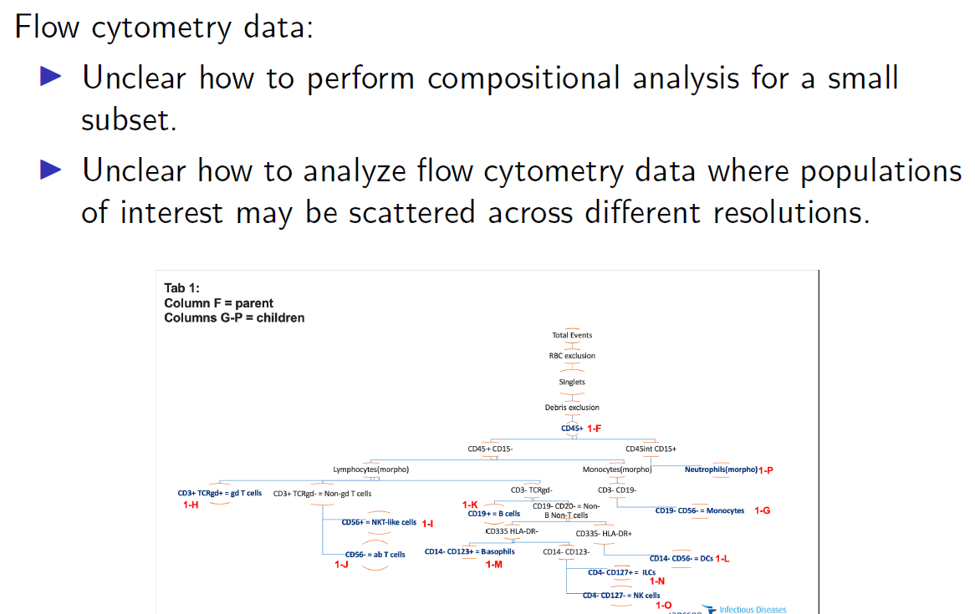
Still working on this approach

Slide 30
Unsupervised Clustering

Slide 31
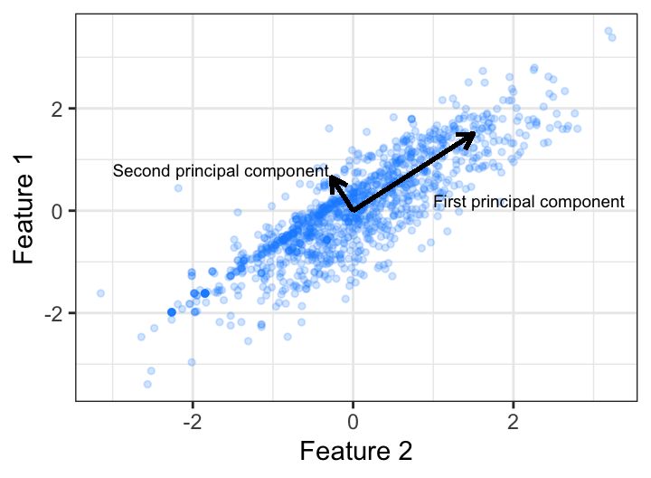
Principal Components
Dimension reduction
1. Plot n predictors in n-dimensional space
The dimension with the largest amount of variance is the first principal component, the orientation that accounts for the most variance in the data
2. Searches for the next greatest amount of variance orthogonal to PCA1
3. This continues until you have n principal components

Slide 32
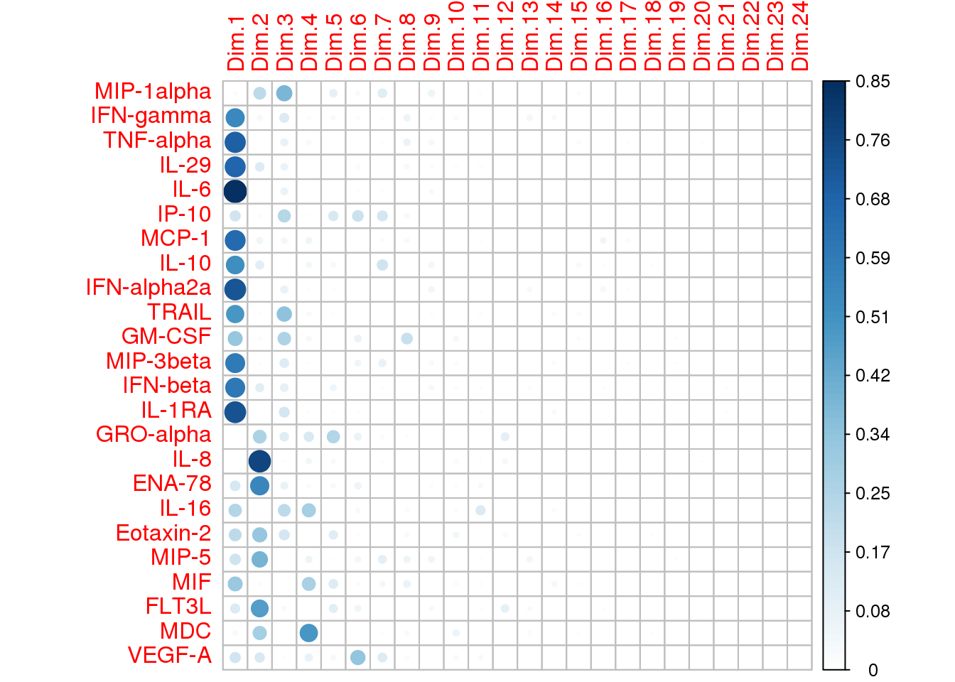
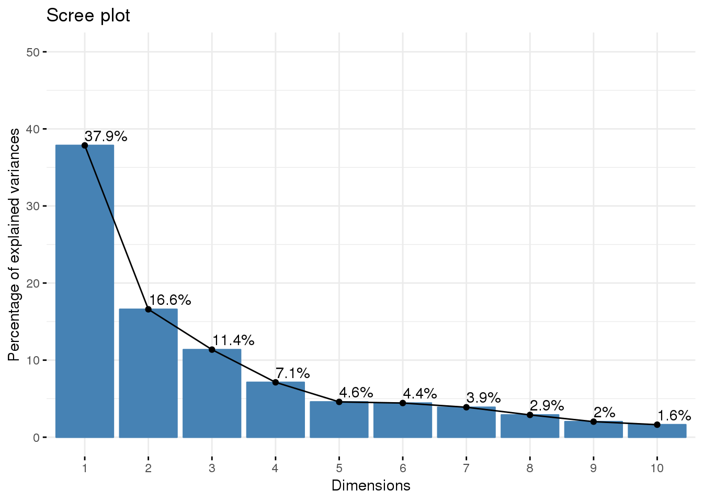
PCA Dimension Reduction

Slide 33
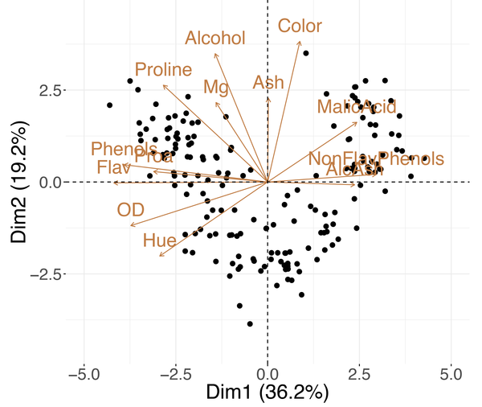
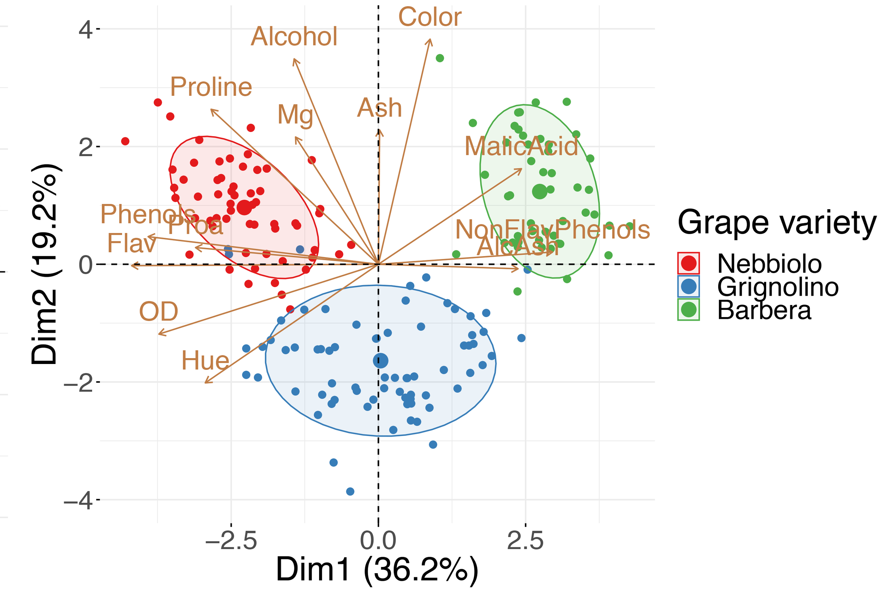
Toy Example, Grape Varieties

Slide 34
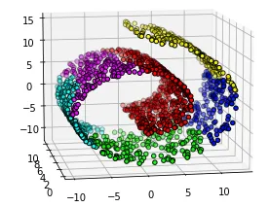
PCA
Good for preserving global structure
Can be used to convert data to components in PC regression
You can overlay defined group on PCA biplot to see (or not see) evidence of data-informed clusters
Fails for non-linear relationships and isn’t great for local relationships
https://newmortalbeing.medium.com/understanding-t-sne-d869ece441a5

Slide 35
t-SNE

Slide 36
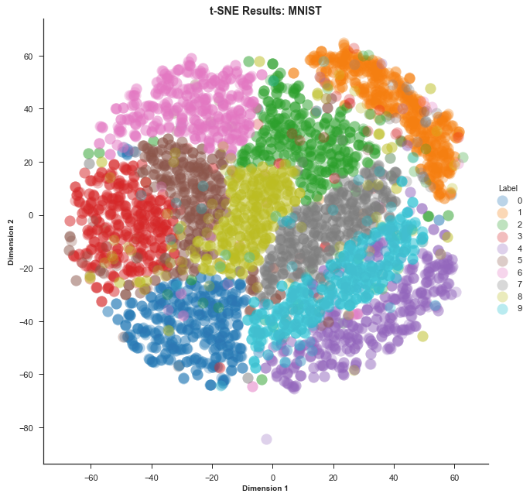
t-SNE
t-Distribution Stochastic Neighbor Embedding
Transforms high-dimensional data into low-dimensional data for easy visualization, especially with regard to clusters
https://distill.pub/2016/misread-tsne/
https://www.google.com/search?q=t-SNE+video&rlz=1C1GCEU_enUS943US943&oq=t-SNE+video&aqs=chrome..69i57j33i160.2089j0j7&sourceid=chrome&ie=UTF-8#fpstate=ive&vld=cid:6c22aa27,vid:NEaUSP4YerM

Slide 37
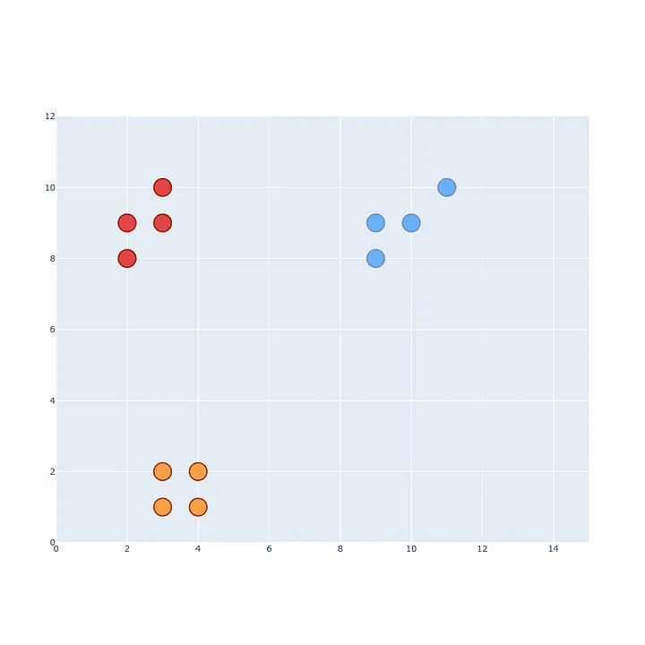
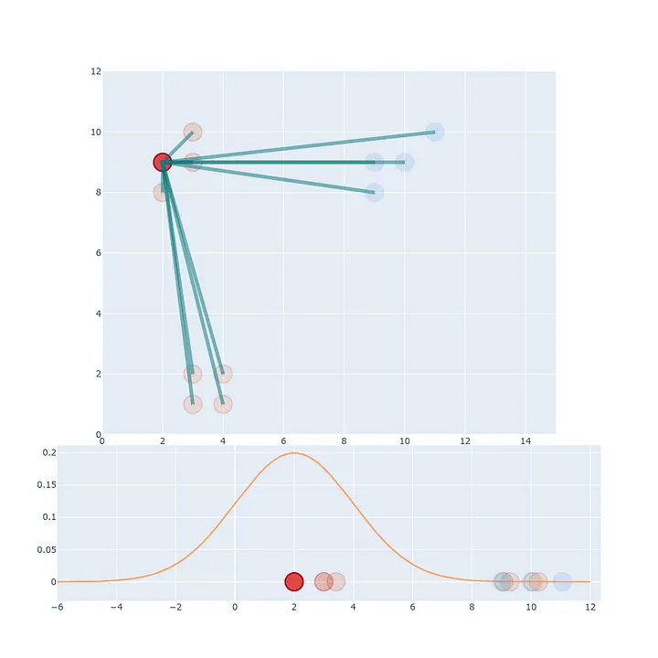
t-SNE step 1: The high-dimensional space
The distances of each point from x1 are scaled to sum to 1
https://towardsdatascience.com/t-sne-clearly-explained-d84c537f53a#:~:text=How%20t%2DSNE%20works%3F

Slide 38
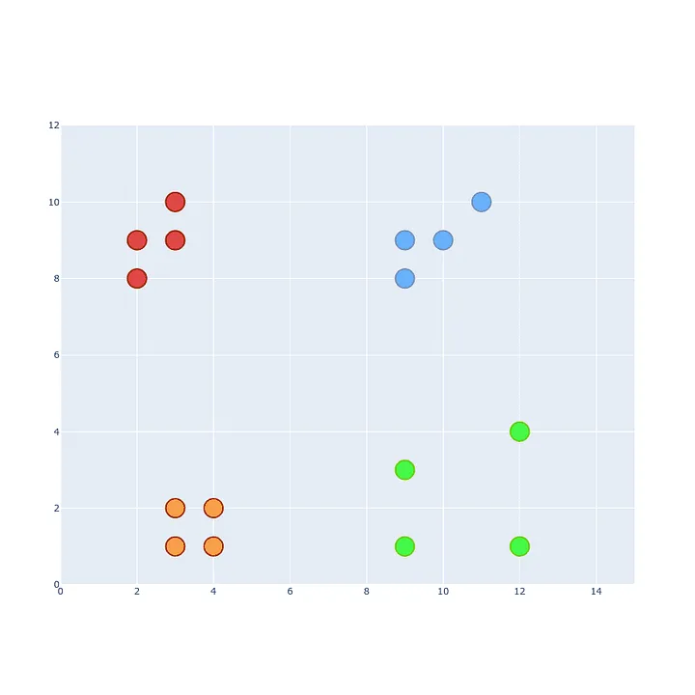
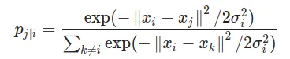
Each projection distance is scaled by the sum of all the projections
Makes everything sum to 1
Accounts for sparse vs. dense clusters

Slide 39
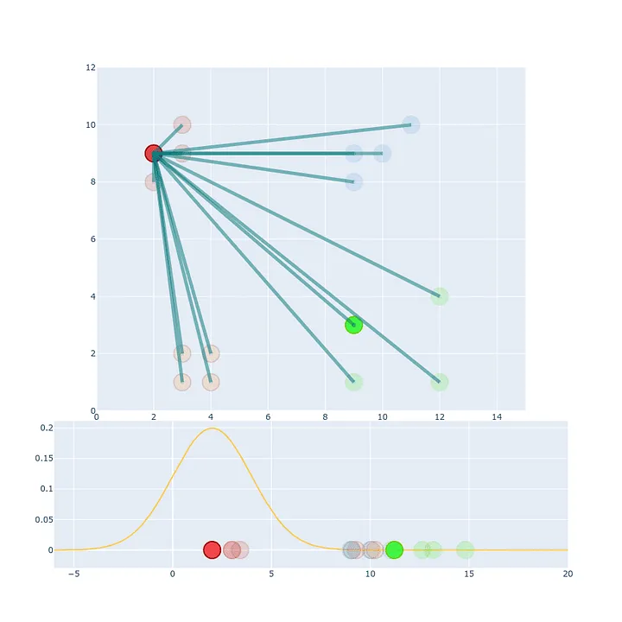
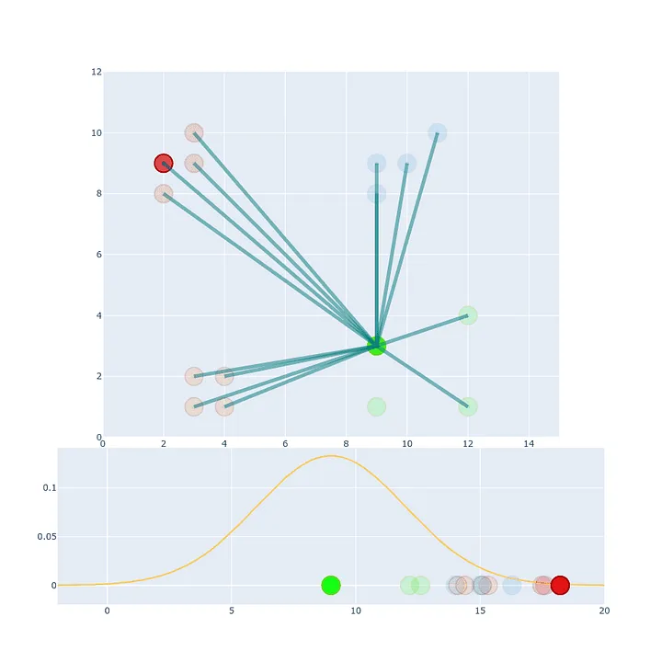
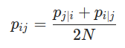
Averaging Distances
A -> B projection value might not be the same as the b -> projection value
This is solved by averaging

Slide 40
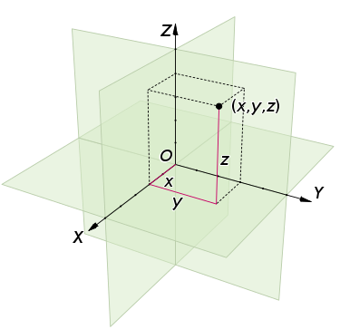
Euclidean Distance
Our points aren’t just in 2-D space, they’re in n-D space
How do you calculate the distance between two points in high dimensional space?

Slide 41
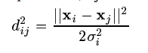
Euclidean Distance
$$ⅆ\left(x_{i},x_{j}\right)=\sqrt{{\left(x_{i1}−x_{j1}\right)}^{2}+{\left(x_{i2}−x_{j2}\right)}^{2}+…+{\left(x_{in}−x_{jn}\right)}^{2}}$$
 | a | b | c | d
a | 0 | 1 | 1 | 1
b | 1 | 0 | 0 | 1
c | 1 | 0 | 0 | 1
d | 1 | 0 | 1 | 0
 | a | b | c
b | 2
c | 1.732 | 1
d | 1.414 | 1.414 | 1.732
distance between the a and b columns:
a = (0, 1, 1, 1)
b = (1, 0, 0, 0)
d(a, b) = √[ (0-1)² + (1-0)² + (1-0)² + (1-0)²] = √4 = 2
distance between the a and b rows:
a = (0, 1, 1, 1)
b = (1, 0, 0, 1)
d(a, b) = √[ (0-1)² + (1-0)² + (1-0)² + (1-1)²] = √3 = 1.732
 | a | b | c
b | 1.732
c | 1.732 | 0
d | 1.732 | 1.414 | 1.414

Slide 42
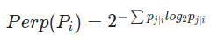
Perplexed?
Perplexity: A perplexity target number of neighbors for each x_{i}
Not the number of clusters, rather cluster size
Typical values between 5 and 50
Cannot be greater than your sample size!!
SNE is robust to changes in perplexity, meaning your choice is probably not too wrong
Shannon entropy/
Amount of “surprise”

Slide 43
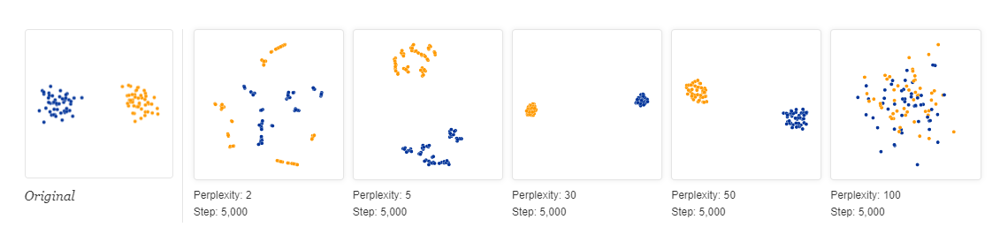
Impact of perplexity choice
How to choose perplexity?
Trial and Error
KNN rule of thumb – optimal K ~ sqrt(N)
30 seems to work well a lot
https://distill.pub/2016/misread-tsne/
https://towardsdatascience.com/how-to-tune-hyperparameters-of-tsne-7c0596a18868

Slide 44
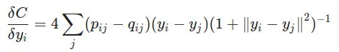
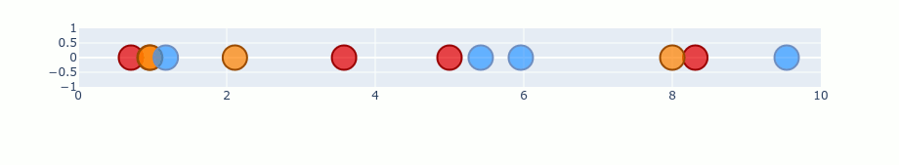
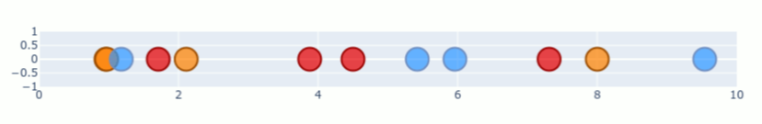
t-SNE: Stochastic Process & t-distribution
High-D space used Normal distribution but
that leads to crowding
Low-D space uses the t-distribution with 1 degree of freedom
Optimizing the match between the low and high dimensional space the Kullback-Leibler divergence (minimizes difference between the two)

Slide 45
UMAP

Slide 46
UMAP
Uniform Manifold Approximation and Projection
“At a high level, UMAP uses local manifold approximations and patches together their local fuzzy simplicial set representations to construct a topological representation of the high dimensional data”
https://pair-code.github.io/understanding-umap/#:~:text=UMAP%2C%20at%20its%20core%2C%20works,as%20structurally%20similar%20as%20possible.
https://www.google.com/search?q=umap+for+dummies&rlz=1C1GCEU_enUS943US943&oq=UMAP+for+dummies&aqs=chrome.0.0i512j0i390i650l2.5523j0j7&sourceid=chrome&ie=UTF-8#fpstate=ive&vld=cid:a3221e09,vid:6BPl81wGGP8

Slide 47
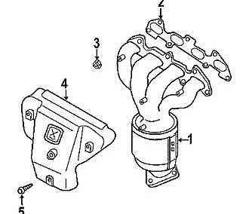
Manifolds
The word manifold comes from the Old English word manigfeald
from the Anglo-Saxon manig [many] and feald [fold]
refers to the folding together of multiple inputs and output
The exhaust manifold in your car collects the exhaust gases from multiple cylinders into one pipe
https://en.wikipedia.org/wiki/Exhaust_manifold

Slide 48
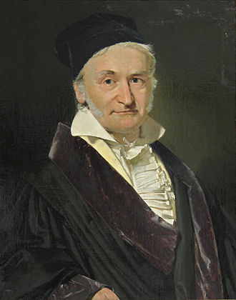
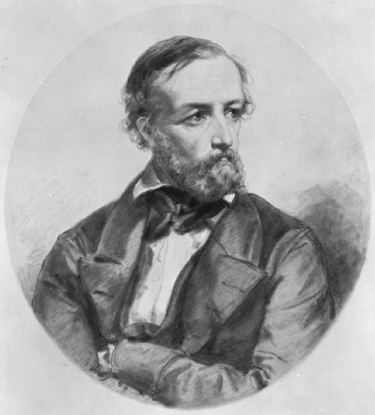
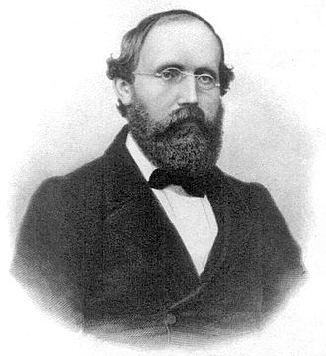
Riemann Manifold
Bernhard Riemann (1826-1866)
Studied with Johann Gauss and Johann Dirichlet
German mathematician who contributed to:
Pure math, prime number counting theory, complex numbers (i), Differential geometry, the best unsolved hypothesis ever, etc
Riemann integral (first complete calculus integral)
https://en.wikipedia.org/wiki/List_of_things_named_after_Bernhard_Riemann
Riemann Manifold
Combines topology and geometry to achieve data reduction

Slide 49
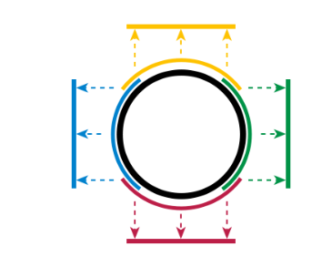
A circle can be simplified into a square
Charts
A circle is a 2-dimensional shape
Topology assumes curves and straight lines are the same things
The circle can be fully dived up into 4 equal/overlapping arcs than translate to lines (“Charts”)
All charts together describe the circle and are called an “Atlas”
The equation that connects the two is a “transition map”
Now the circle can be represented by multiple segments in 1-dimensional space
You can map a sphere to a disc, etc
https://en.wikipedia.org/wiki/Manifold

Slide 50
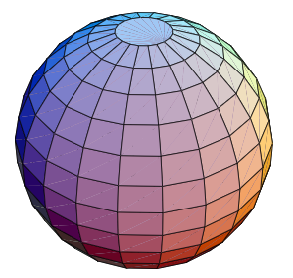
A 3D Example
“A manifold is a topological space that is locally Euclidean”
Around every point, there’s a neighborhood that that topologically “flat”
If you’re standing on a giant sphere, where you are might look flat
https://mathworld.wolfram.com/Manifold.html

Slide 51
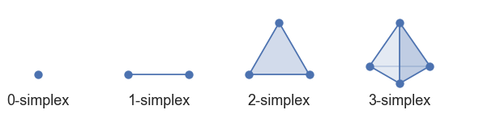
Simplexes
UMAP begins by building the topological space with simplexes
How to pick those simplexes?
Each data point gets a radius
Points with overlapping radii are lumped into same simplex

Slide 52
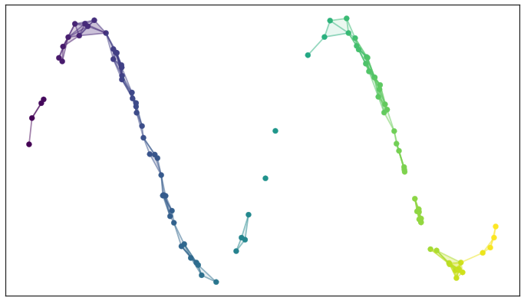
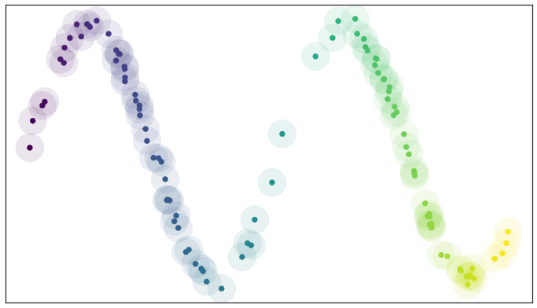
Simple simplex visualization

Slide 53
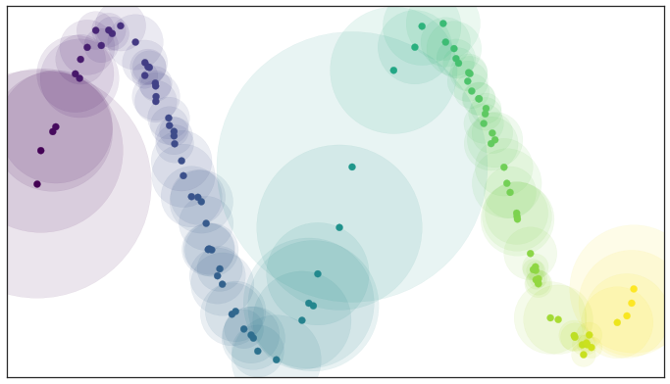
Radius size and variability
We can vary the radii for each point based on the number of neighbors we want each point to have – like perplexity in t-SNE

Slide 54
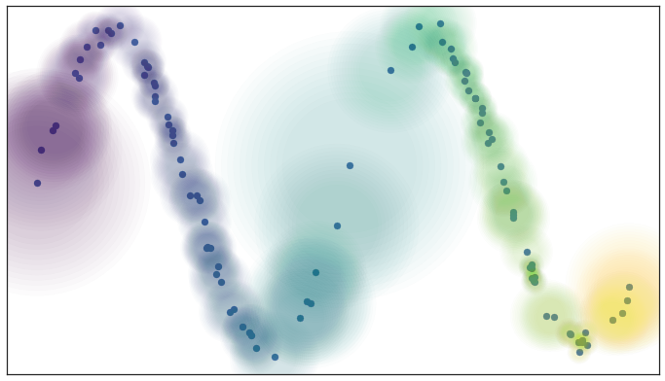
Fuzziness
The edges of our circles don’t have to be binary, yes/no
They can have a gradient probability between 0 and 1, where it’s higher closer to the point and lower further away

Slide 55

Local Connectivity
With just “fuzziness” there is the possibility that points could be isolated
It is a requirement that at any point on the manifold there is some sufficiently small neighborhood of the point that is connected

Slide 56
Resolving Disagreements
Fuzziness and local connectivity can end up creating simplexes that disagree with each other, especially with weighted edges
In t-SNE, we just averaged the Euclidean distances
In the world of fuzzy simplicial sets, you just take the fuzzy union
To merge two disagreeing edges with weight a and b then we should have a single edge with combined weight a+ b – a · b
This is the equation for joint probability
Weights are the probabilities that a connection between two points (“edge”) exists. The combined weight is then the probability that it exists.

Slide 57


Slide 58
Creating and connecting the low-dimensional representation
Unlike step 1, the distance on the manifold needs to be a standard (Euclidean or otherwise) distance, not a varying radius
The nearest neighbor in step 1 needs to be globally true across the high and low manifolds as we optimize
Both the high and low dimensional structures share the same 0-simplices (single points), so we can do a neat trick:
We have probabilities of each 1-simplex (single edge) simply existing
That means we have two vectors of probabilities that are Bernoulli variables
That let’s us use Cross-Entropy as a cost function to match up the low-dimensional graph to the high dimensional data

Slide 59
Cross-entropy importance
Attractive force when there are large weights
Repulsive force weights are small
This has nicer features that the KL-divergence and means that both local and global features are maintained.
https://towardsdatascience.com/how-exactly-umap-works-13e3040e1668

Slide 60
PCA vs t-SNE vs UMAP
Characteristic | PCA | t-SNE | UMAP
Speed | Fast and computationally cheap | Slow | Fast-ish
Pros | Reasonably intuitive Good for linear relationships | Good with neighborhood definition, handles non-linearity | Good in illustrating local relationships while preserving global structure
Cons | Bad with outliers, cannot see non-linear clusters | Globally ok, but distance between final clusters is not meaningful, hyperparameter setting can be confusing/wrong | Requires hyperparameters, non-deterministic (repeated UMAPs won’t look the same)
https://towardsdatascience.com/dimensionality-reduction-for-data-visualization-pca-vs-tsne-vs-umap-be4aa7b1cb29

Slide 61
Comparing t-SNE and UMAP
Live Demo
https://pair-code.github.io/understanding-umap/#:~:text=UMAP%2C%20at%20its%20core%2C%20works,as%20structurally%20similar%20as%20possible.

Slide 62
Heatmaps

Slide 63

Data Viz and Clustering: Dendrograms
Remember Euclidean Distances?
Start from the bottom up, plotting the smallest distance first
b and c have the smallest distance at 1.
The next smallest distance is 1.414, shared by both b and d and a and d, but b is already grouped with c,
So a and d are plotted.
All items have been grouped so the highest Euclidean distance (2 in this case) is plotted to connect the two groups.
 | a | b | c
b | 2
c | 1.732 | 1
d | 1.414 | 1.414 | 1.732

Slide 64


Heatmaps
Centering and scaling is almost often required to put samples/subjects on the same footing
These are effectively z-scores (subtract the mean, divide by SD)

Slide 65

Heatmaps and Dendrograms
Agglomerative clustering on the direction of interest (in this case, the rows) informs the dendrogram
Because we are comparing vectors, we use Euclidean distance
There are a few different algorithms
With small samples, very little difference
We can interpret this clustering of the heatmap as which clones behave more like each other

Slide 66

Heatmaps and Dendrograms
We can also cluster in the column direction and see which cell types are most similar across clones
We could also look at both simultanously

Slide 67
More Topics

Slide 68
Automated Gating
Automated gating
FlowJo plug-in EZ-DAFI
Shiny app by Pharmalex
Statistician concerns
Operator error/bias
Quality of the automated gating algorithm
Discuss?

Slide 69

Data transformation in FlowJo
Log-transformation: log(x)
pros: historical, intuitive, easy
cons: can’t handle 0 and negative values, piles low values up close to 0
Bi-exponential / “logicle”:
S(a, b, c, d, f) = ae^{bx} - ce^{dx} +f
based on the hyperbolic sine function, linear near 0
Sinh(x) = (e^{x} – e^{-x})/2
5 parameters are fixed and represent:
Max data value in displayed scale (T)
Range of display in relation to width of high data value decades (M, m)
Strength and range of linearization around 0 (W, w)
Range of negative values to be included

Slide 70


Bi-ex vs. Log

Slide 71


Other transformations
Additional transformations are related to the Bi-ex, and use different approaches to handle data near zero
Arcsinh: $ln⁡(x+\sqrt{x^{2}+1})$
Hyperlog: ae^{bx} - cx +f
Miltenyi: if your data comes from Miltenyi cytometers

Slide 72
Events and power
Topic for further discussion
Typically, we think of power as sample size, i.e., number of samples or subjects
Thinking about a number of events that constitute a “real” signal within a single sample requires discussion around
Probability distribution of data
Sensitivity around assay, assay validation concepts

Slide 73


Dose Response / Fold Expansion
Topic for further discussion

Slide 74
More Stuff We Like
Doing things right in Prism
We have slides decks on dose response, t-test & ANOVA, and longitudinal data analysis in GraphPad Prism
Statistical Awareness series
Based on the Nature Methods Point of Significance series
https://www.nature.com/collections/qghhqm/pointsofsignificance

Slide 75
Sources
Comparing UMAP vs t-SNE in Single-cell RNA-Seq Data Visualization, Simply Explained https://blog.bioturing.com/2022/01/14/umap-vs-t-sne-single-cell-rna-seq-data-visualization/
Dimensionality Reduction for Data Visualization: PCA vs TSNE vs UMAP vs LDA https://towardsdatascience.com/dimensionality-reduction-for-data-visualization-pca-vs-tsne-vs-umap-be4aa7b1cb29
Dimension Reduction PCA, tSNE, UMAP, Integration https://www.bioinformatics.babraham.ac.uk/training/10XRNASeq/Dimension%20Reduction.pdf
UMAP: Uniform Manifold Approximation and Projection for Dimension Reduction https://arxiv.org/pdf/1802.03426.pdf
Understanding t-SNE https://newmortalbeing.medium.com/understanding-t-sne-d869ece441a5
Stochastic Neighbor Embedding https://cs.nyu.edu/~roweis/papers/sne_final.pdf
How to Use t-SNE Effectively https://distill.pub/2016/misread-tsne/
Understanding UMAP https://pair-code.github.io/understanding-umap/#:~:text=UMAP%2C%20at%20its%20core%2C%20works,as%20structurally%20similar%20as%20possible.
UMAP clearly explained https://medium.com/@zahraelhamraoui1997/umap-clearly-explained-6324711c855b
The Beginner’s Guide to Dimensionality Reduction https://dimensionality-reduction-293e465c2a3443e8941b016d.vercel.app/
Data Transformation (FlowJo) https://docs.flowjo.com/flowjo/graphs-and-gating/gw-transform-overview/
A new "Logicle" display method avoids deceptive effects of logarithmic scaling for low signals and compensated data
https://pubmed.ncbi.nlm.nih.gov/16604519/
Data Transformations https://dillonhammill.github.io/CytoExploreR/articles/CytoExploreR-Transformations.html#arcsinh-transformation-1

